Slide 1


Getting Your Bite
Airbnb Properties in New York City
Presentation by:
Jason Carey, Charles Dixon, and Amy McMahon

Slide 2
Motivation
“Air BNB is a global network of For Rent By Owner Vacation rentals. In 2017 Airbnb earned $2.6B in Revenues, expecting to top $4B for 2018. As a result this area has become a hot bed for investors looking to invest in the real estate market and collect a premium on their investment over traditional real-estate investments."

Slide 3

Summary
This project used Air BNB data available on Kaggle.com encompassing one year of rental information for New York City.
The data was analyzed with a view towards making decisions on finding the highest revenue potential properties.

Slide 4
Data analysis questions
What is the best the best zip code to invest in?
Which Boroughs have the most successful investment properties?
Use the data to define successful investment criteria:
Frequency of rental
How much revenue can you generate per year?
Use data to inform investment decisions in regards to mortgage
Type of property
Is there a holiday that is potentially more profitable?

Slide 5

Data cleanup & Exploration
The data set has one year of Air BNB rental information, including information on the location, host, cost and amenities
The ratings data was sparse, so we did not include a ratings analysis, aside from super host designation.
The location information was invaluable and included city, borough, and zip code. We used these attributes to group the data and find the top revenue generators.
The host information allowed us to research hosts that had multiple properties (fellow investors) to determine where and what type of properties they invested in.

Slide 6
The Process
16182640
16182640
Identified the data on Kaggle
Downloaded the four Airbnb files directly to our computers because of the size
Began importing the data (16,182,640 lines in the “CalendarData”)
Reviewed a sample of the data lines
Eliminating null values is some data sets
Merged the four filed into one data frame
Attempted to identify correlations of data points

Slide 7
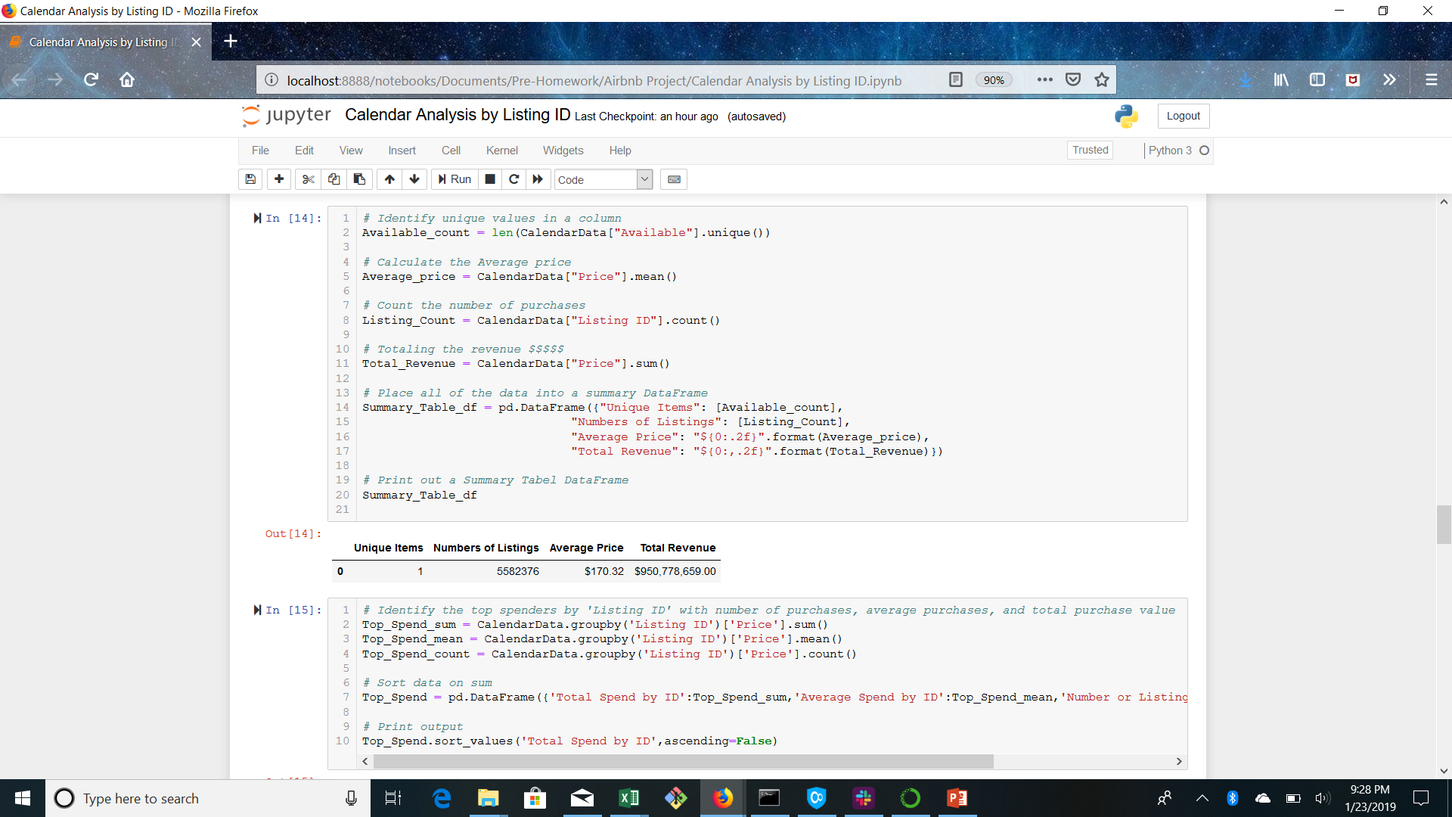
Raw data insights
Shocked by the number of rows.
Airbnb provided a ton of data
Written reviews were almost nonexistent
Rating detail such as cleanliness was sparse

Slide 8
Data Exploration
The market is worth $950 million annually
In New York City in 2017/2018 there were 5,582,376 nights rented
The number of active listings during the year was 28,735
We identified the Zip codes with the highest occupancy rates and revenues
We identified the hosts with the highest revenues

Slide 9
Findings
We were able to perform the analysis to allow an investor to make a better decision.
We identified the top boroughs to invest in.
We identified the top zip codes
Best hosts to use for management
Holidays that capture the most revenue
Average revenue by hosts
Average revenue by zip code
Total value of the market
Booking occupancy rates

Slide 10
Highlights of analysis
Zip codes with the highest percentages
The market is worth $950,778,659 annually
In New York City in 2017/2018 there were 5,582,376 nights rented
The number of active listings during the year was 28,735 with 15,582 Airbnb rentals having no income
The Average Revenue from and Airbnb rental was $33,087.83
Average Occupancy Rate of 53%
Numbers of Listings Average Price Total Revenue
5,582,376 $170.32 $950,778,659.00

Slide 11
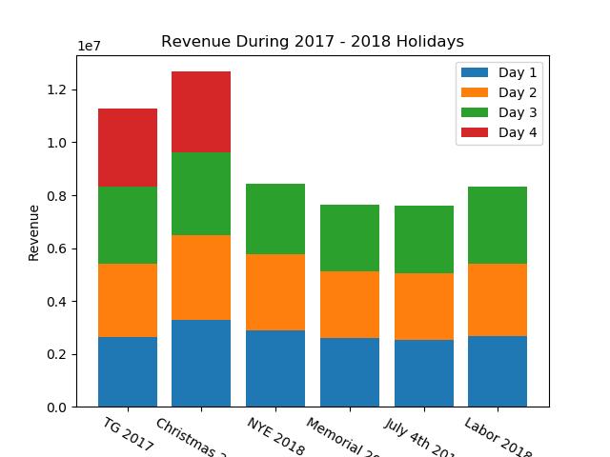
Revenue during the holidays
Noted Christmas bookings bring in the most revenue even at just three days.
Surprised that Thanksgiving, New Years Eve, and Labor Day are about the same for three days of rentals.
Four day weekends will always be available for Thanksgiving but occasionally for Christmas

Slide 12
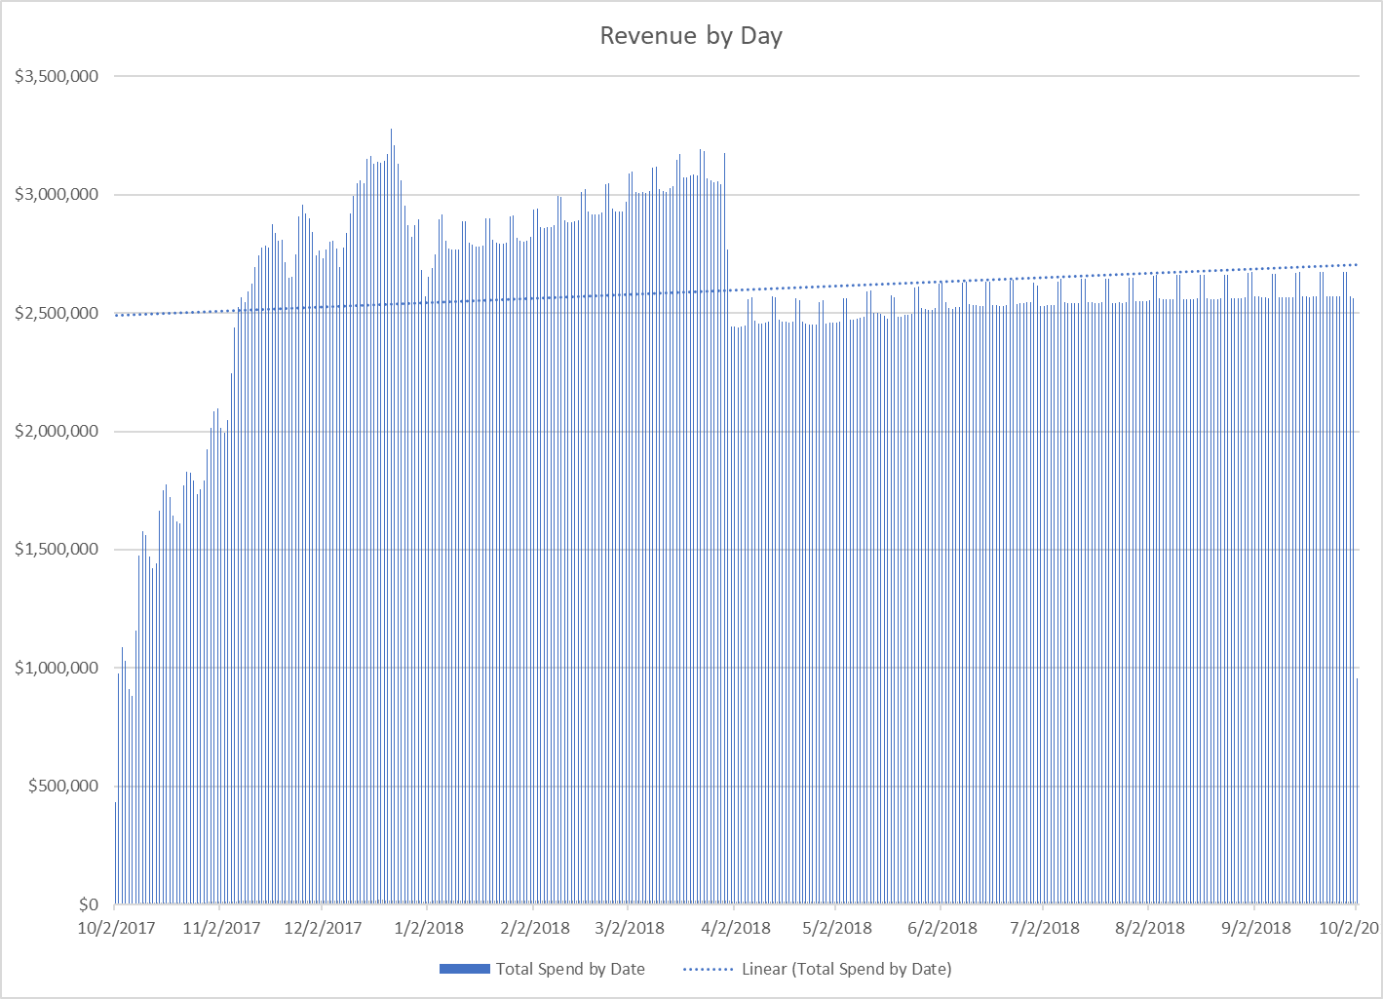
Revenue by Day
?
Appears something took place in May to decrease the revenue.
Noted the weekends are high points.
Noted there is a steep ramp up of activity.

Slide 13
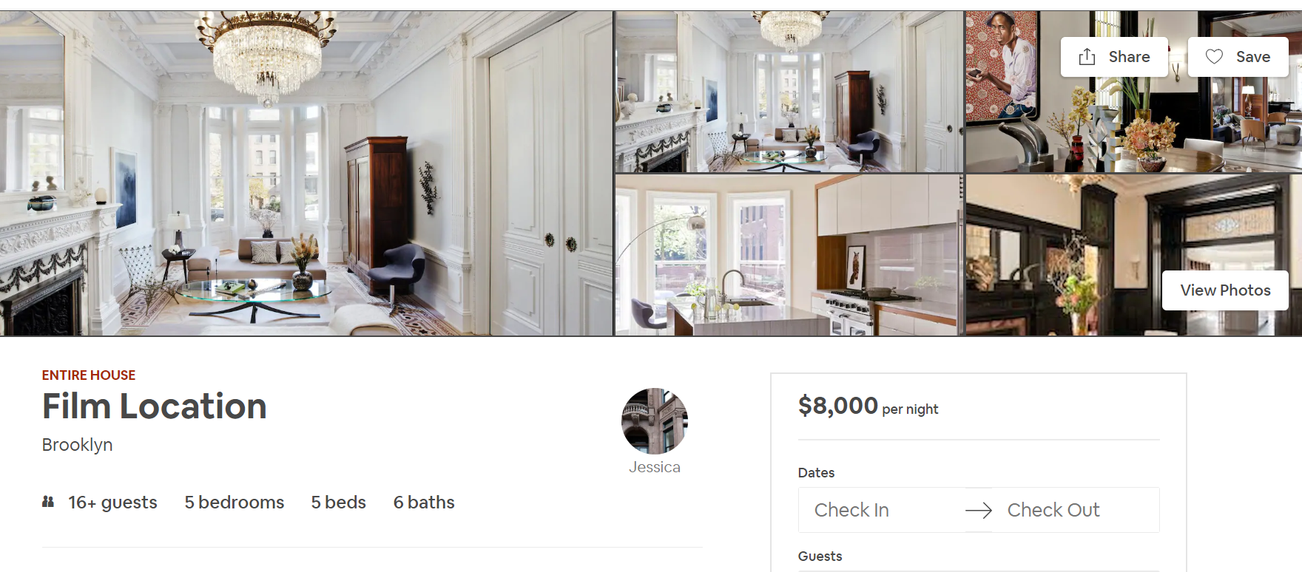
#1 Air BNB Rental in NYC
$2.92 Million
Annual Revenue

Slide 14
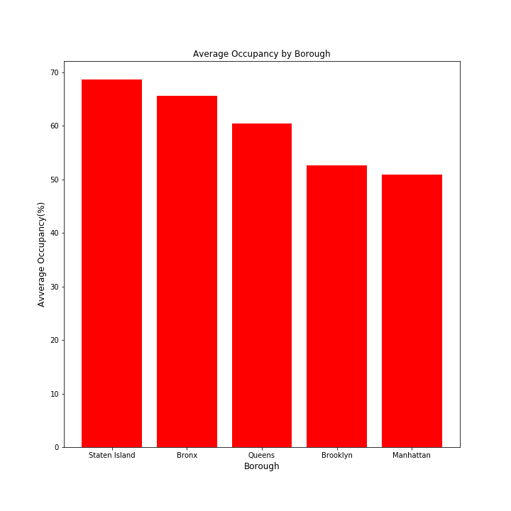
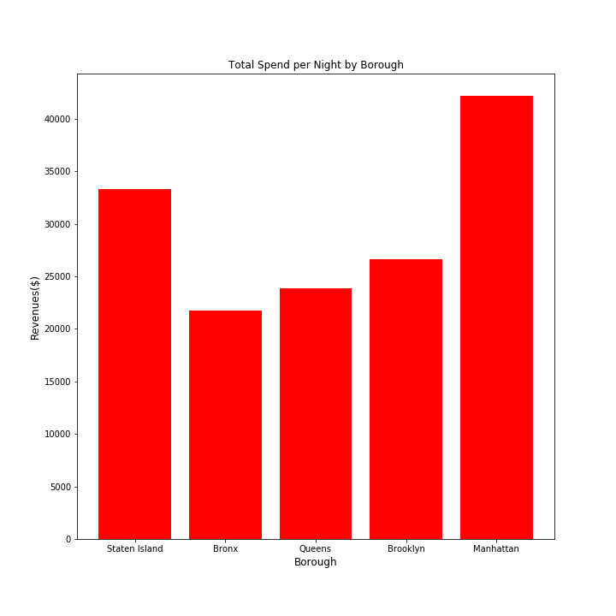
Rentals by Borough
Best Borough to Rent in
Staten Island
69% Occupancy Rate
$121 per night avg rental
$3,3286 avg per annum
Manhattan
69% Occupancy Rate
$207 per night avg rental
$42,151 avg per annum

Slide 15
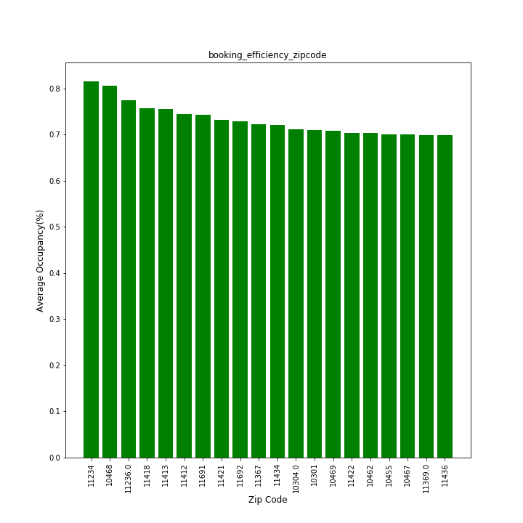
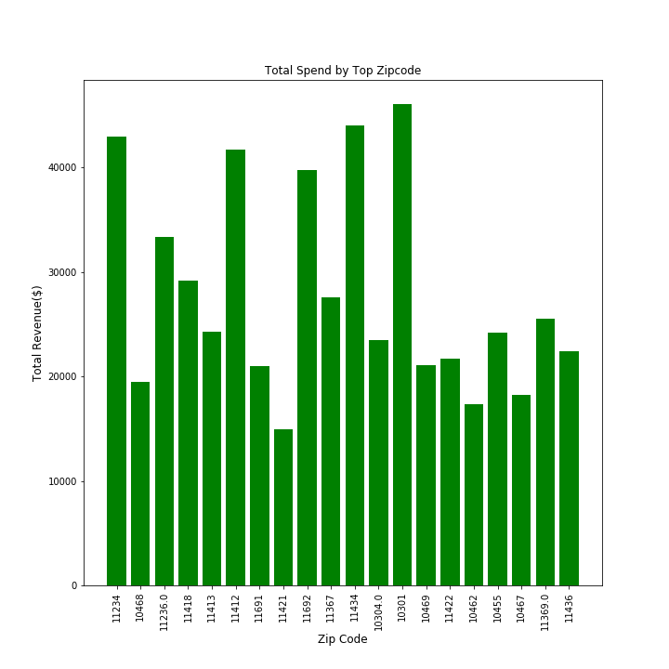
Percent Occupancy and Total Revenues by Zip code
Best Zip Codes to Rent in
11234 - 81% Occupancy, $42,975 average annual revenue per annum
11412 - 74% Occupancy, $41693 average annual revenue per annum
11434, 72% Occupancy, $43,984 average annual revenue per annum
10301, 71% Occupancy, $46,022 average annual revenue per annum
Manhattan
69% Occupancy Rate
$207 per night avg rental
$42,151 avg per annum

Slide 16
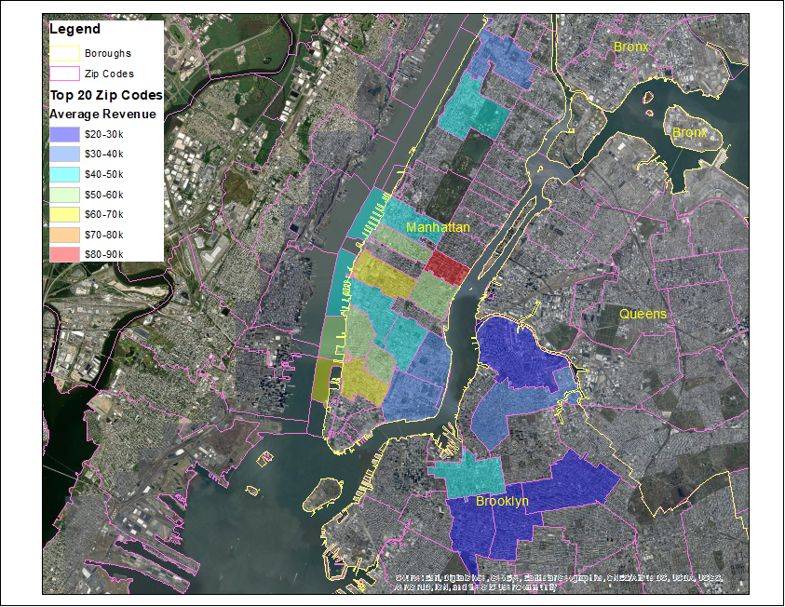
Map displaying to Zip codes by Revenue

Slide 17

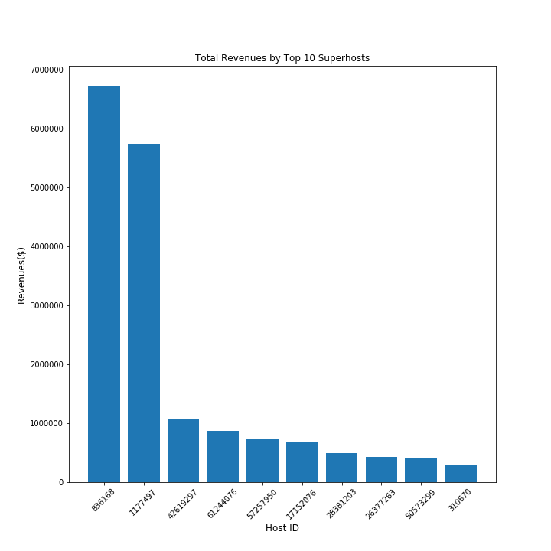
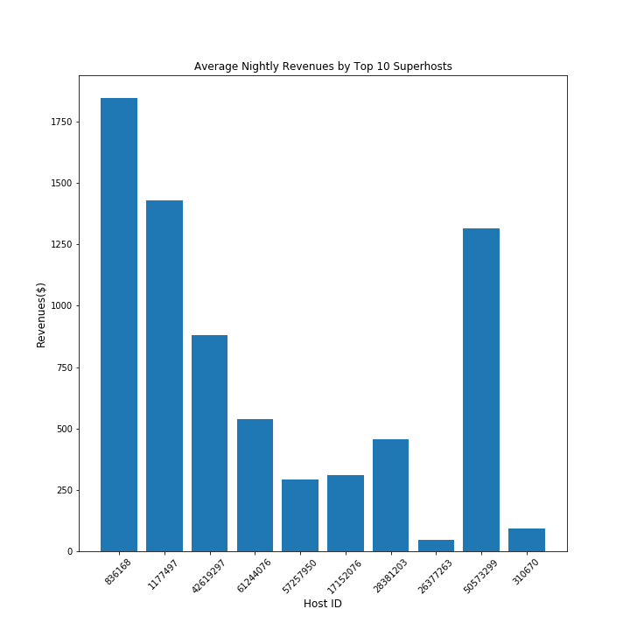
Super Hosts
Super Hosts
$166.38 per night rental
$35,442 average per annum
54% occupancy rate
Host
$160.05
$32,647 average per annum
53% occupancy rate
Top 10 Super Hosts
$720 per night rental
$1.74 M per annum
89% occupancy rate

Slide 18
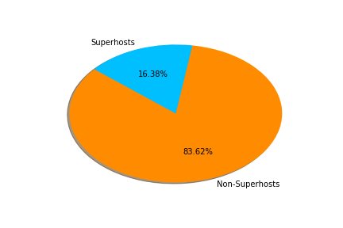
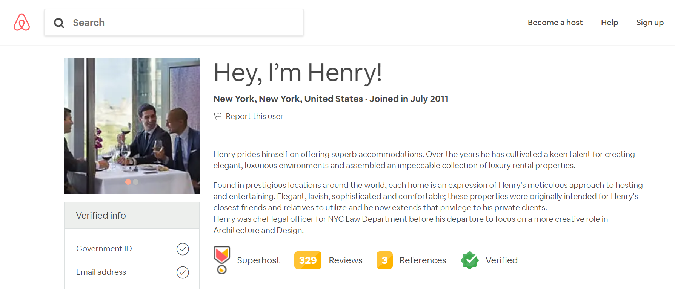
Super Hosts
Henry
$1845.07 per night rental
$6.72M average per annum
99% occupancy rate

Slide 19

Post mortem

Slide 20

Additional questions
Determine the financial impact of NYC’s “Home sharing Surveillance Ordinance” that appears to have taken affect in in April of 2018.
Analyze the revenue by number of units and borough.
Statistical analysis to see if there is a correlation between price and occupancy.
Compare our one year of data over a longer time period.
Identify the best type of property to invest in (i.e. houses, apartments, or houseboat)

Slide 21

Difficulties
So many interesting questions and additional datasets (NYC crime, NYC Uber, and NYC Yelp) available for analysis
Defining parameters once we settled on a dataset
Low memory errors because of the number of columns
Working with the quantity of data and Git

Slide 22
Questions?

